Slide 1

Javascript function
Chapter 2 of The Principles of Object-Oriented JavaScript
تطبيقات البرمجة الهدفية
العارف عبد الباسط أبو شعالة
1822294

Slide 2
Table of content
Functions in javascript.
Declaration VS Expression.
Functions as values
Parameters
Overloading
Object method
The this object
Changing this
The call() method

Slide 3
Introduction
A function in JavaScript is similar to a procedure—a set of statements that performs a task or calculates a value, but for a procedure to qualify as a function, it should take some input and return an output where there is some obvious relationship between the input and the output

Slide 4

Function in javascript
Functions is considered as objects in javascript.
The [[Call]] property is what makes function special to any other object.

Slide 5
[[Call]]
The [[Call]] property is unique to functions and indicates that the object can be executed.

Slide 6
02
Declaration vs Expression

Slide 7
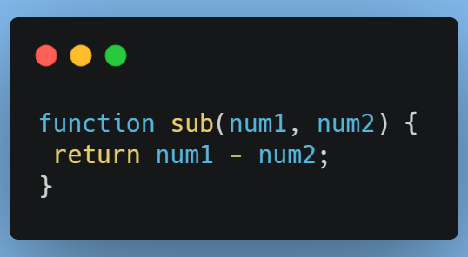
Declarations
begins with the function keyword and the name of the function following it. The contents of the function are enclosed in braces, as shown in this exmaple:
Function declarations are hoisted to the top of the context.
Hoisted is a JavaScript mechanism where variables and function declarations are moved to the top of their scope before code execution.

Slide 8
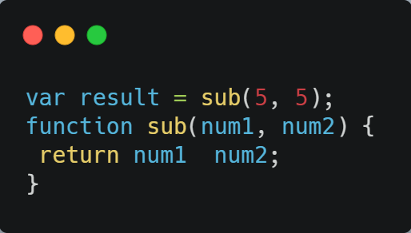
Declarations
Function declarations are hoisted to the top of the context.
Hoisted means you can actually define a function after it is used in code without generating an error, for example:
JavaScript engine hoists the function declaration to the top and actually executes the code as if it were written.

Slide 9
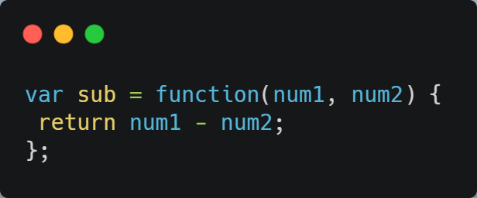
Expression
You don’t need to put a name after the function in function Expression (anonymous), Instead, function expressions are typically referenced via a variable or property, as in this expression:
semicolon at the end.

Slide 10
03
Functions as values

Slide 11
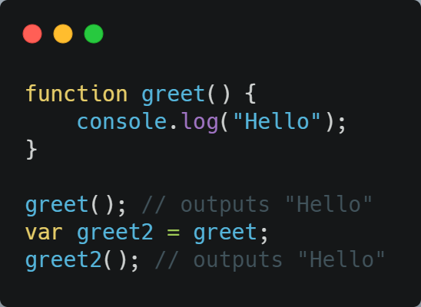
Functions as values
you can use Javascript Functions just as you do any other objects. You can assign them to variables, add them to objects, pass them to other functions as arguments, and return them from functions.
Both greet and greet are now pointing to the same function, and that means either can be executed

Slide 12
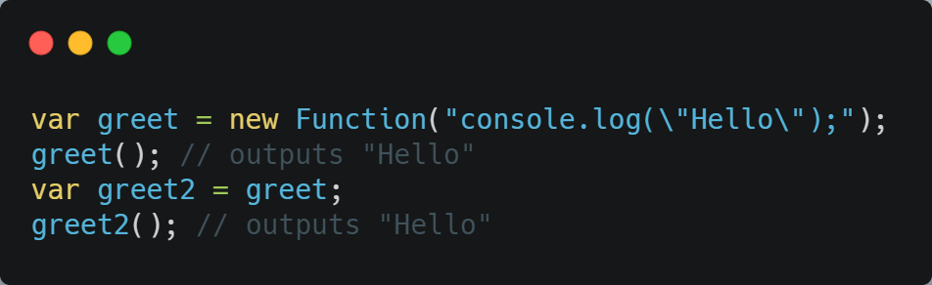
Functions as values
take a look at the same code rewritten to use the Function constructor:

Slide 13
04
Parameters

Slide 14
Parameters
You can pass any number of parameters to any function without causing an error.
function parameters are actually stored as an array-like structure called arguments.
there is a length property to determine how many values are present

Slide 15
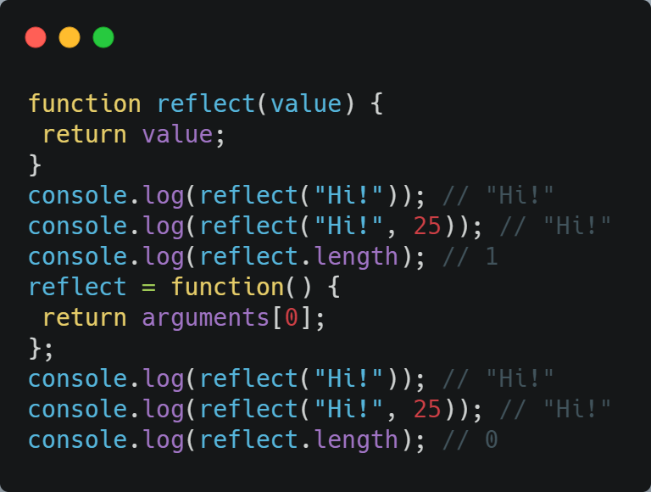
Paramters
Here’s a simple example using arguments and function arity; note that the number of arguments passed to the function has no effect on the reported arity:
Single named parameter
No error here when the second parameter is passed
The length property is 1 because there is a single named parameter

Slide 16
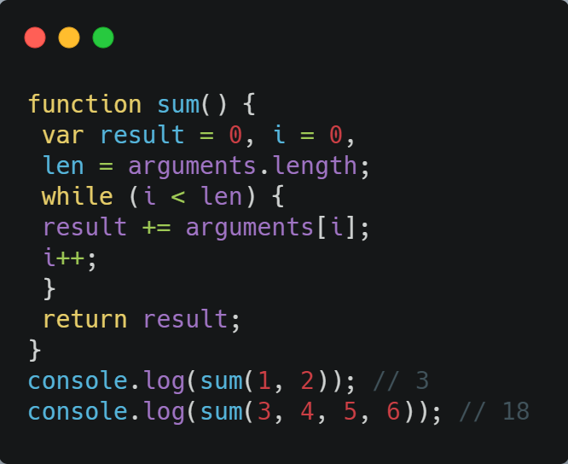
using arguments is actually more effective than naming parameters
suppose you want to create a function that accepts any number of parameters and returns their sum

Slide 17
05
Overloading

Slide 18
Overlaoding
Overloading is the ability to create multiple functions of the same name with different implementation
A function signature is made up of the function name plus the number and type of parameters the function expects.

Slide 19
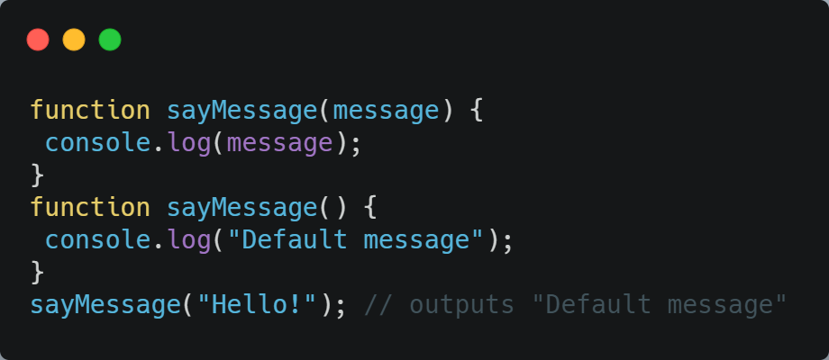
Lack of function signature
JavaScript functions don’t actually have signatures. A lack of function signatures also means a lack of function overloading. Look at what happens when you try to declare two functions with the same name:
when you define multiple functions with the same name In JavaScript, the one that appears last in your code wins.

Slide 20
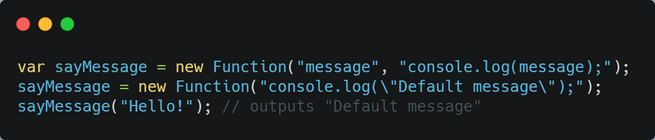
The one that appears last wins!
Looking at the code this way makes it clear why the previous code didn’t work. A function object is being assigned to sayMessage twice in a row, so it makes sense that the first function object would be lost

Slide 21
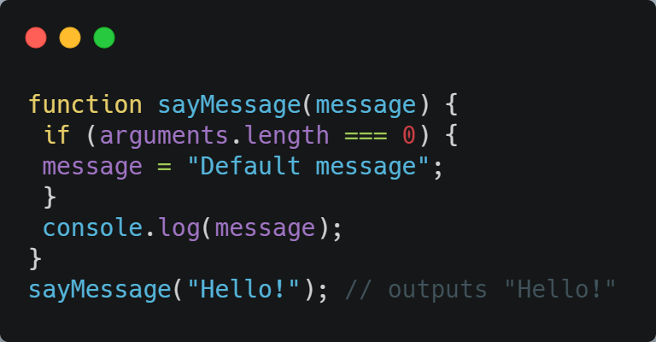
Mimic the function overloading
Using the length property to mimic the function overloading

Slide 22
06
Object methods

Slide 23
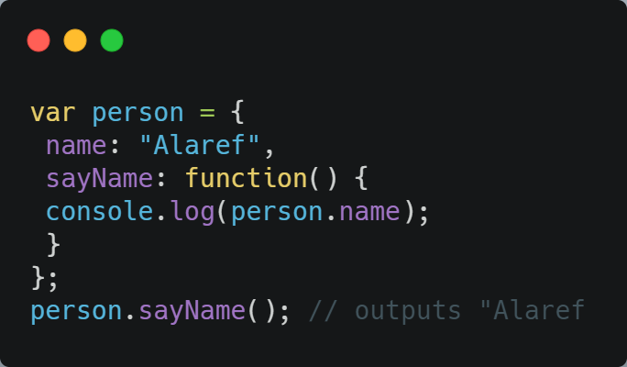
Object method
When a property value is actually a function, the property is considered a method.
For example, in the following code, the person variable is assigned an object literal with a name property and a method called sayName.
You can then call the method directly from the object as in person.sayName("Alaref").

Slide 24
07
The this Object

Slide 25
The this object
You may have noticed something strange in the previous example. The sayName() method references person.name directly which creates tight coupling between the method and the object.
There are two Problems of tight coupling:
1 - if you change the variable name, you also need to remember to change the reference to that name in the method.
2 - this sort of tight coupling makes it difficult to use the same function for different objects.

Slide 26
The this object
Every scope in JavaScript has a this object that represents the calling object for the function.
In the global scope, this represents the global object (window in web browsers).
When a function is called while attached to an object, the value of this is equal to that object by default. So, instead of directly referencing an object inside a method, you can reference this instead

Slide 27
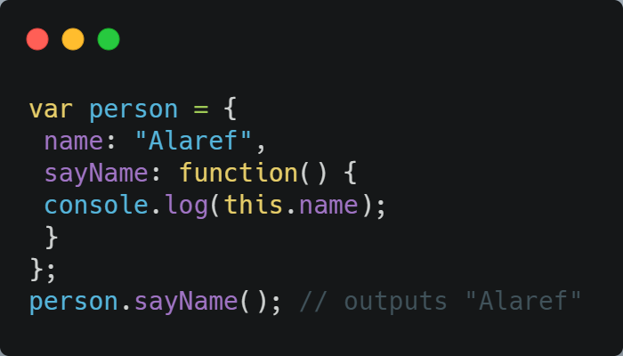
The this object
For example, you can rewrite the code from the previous example to use this:
This code works the same as the earlier version, but this time, sayName() references this instead of person.

Slide 28
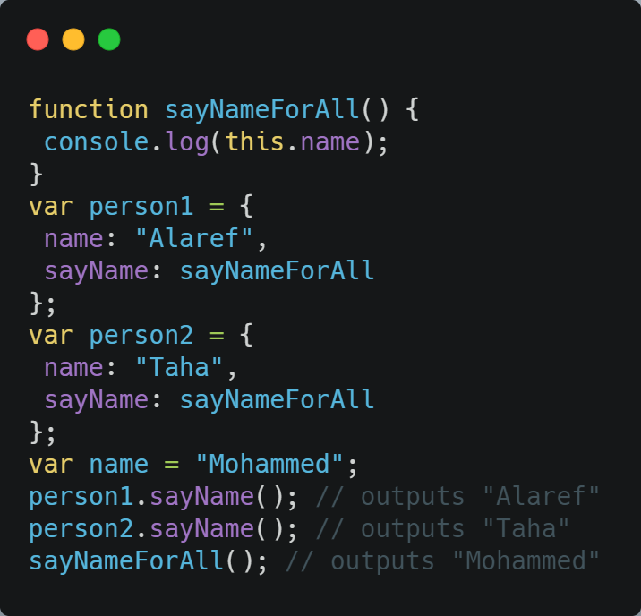
The this object
you can easily change the name of the variable or even reuse the function on different objects.
Reference values
In this example, a function called sayName is defined first. Then, two object literals are created that assign sayName to be equal to the sayNameForAll function
Property of Global object
The last part of this example defines a global variable called name. When sayNameForAll() is called directly

Slide 29
08
Changing this

Slide 30
Changing this
Even though this is typically assigned automatically, you can change its value to achieve different goals. There are three functions methods that allow you to change the value of this :
The call() method.
The apply() method.
The bind() method.

Slide 31
09
The call() method

Slide 32
The call() method
The call() method executes the function with a particular this value and with specific parameters.
The first parameter of call() is the value to which this should be equal when the function is executed
All subsequent parameters are the parameters that should be passed into the function

Slide 33
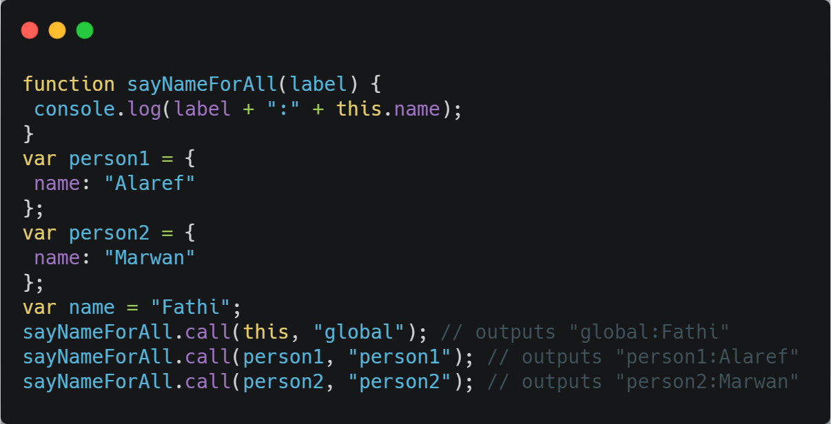
The call() method
For example, suppose you update sayNameForAll() to take a parameter
no parentheses after the function name because it is accessed as an object

Slide 34
The apply() method
The apply() method works exactly the same as call() except that it accepts only two parameters:
the value for this.
and an array or array-like object of parameters to pass to the function
instead of individually naming each parameter using call(), you can easily pass arrays to apply() as the second argument.
Note that you can use an arguments object as the second parameter

Slide 35
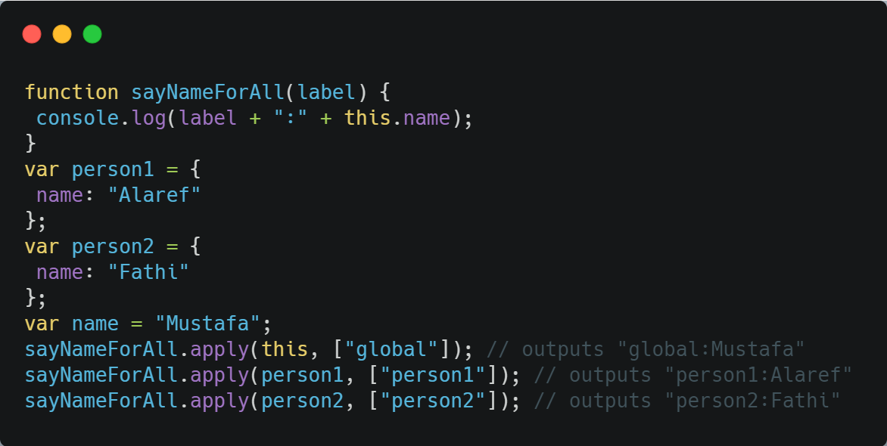
The apply() method
This example shows the apply() method in action:

Slide 36
The bind() method
The first argument to bind() is the this value for the new function. All other arguments represent named parameters.

Slide 37
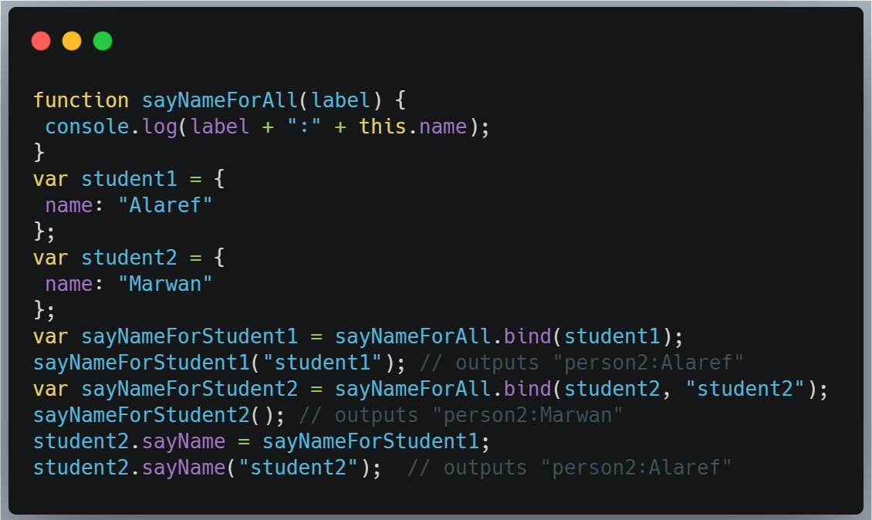
The bind() method
The following code shows two examples that use bind(). You create the sayNameForStudent1() function by binding the this value to person1, while sayNameForStudent2() binds this to person2 and binds the first parameter as "person2".

Slide 38
Thanks
العارف عبد الباسط أبو شعالة

